Slide 1
Descriptive Statistics

Slide 2
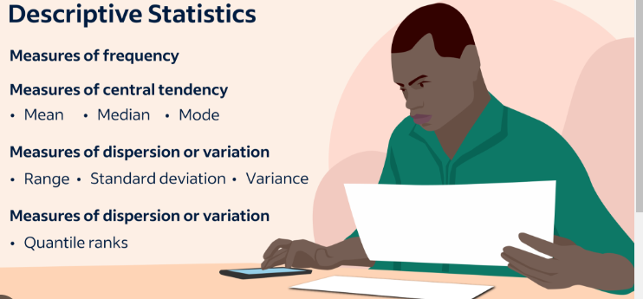
Descriptive Statistics

Slide 3
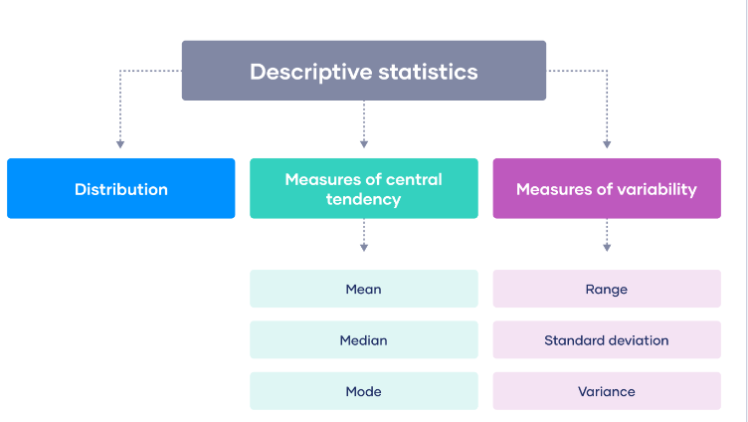
Descriptive Statistics

Slide 4
Standard Deviation
Standard deviation is a statistic that measures the dispersion of a dataset relative to its mean and is calculated as the square root of the variance. The standard deviation is calculated as the square root of variance by determining each data point's deviation relative to the mean.
If the data points are further from the mean, there is a higher deviation within the data set; thus, the more spread out the data, the higher the standard deviation.

Slide 5
Standard Deviation
Standard deviation measures the dispersion of a dataset relative to its mean.
It is calculated as the square root of the variance.
Standard deviation, in finance, is often used as a measure of a relative riskiness of an asset.
A volatile stock has a high standard deviation, while the deviation of a stable blue-chip stock is usually rather low.
As a downside, the standard deviation calculates all uncertainty as risk, even when it’s in the investor's favor—such as above-average returns.

Slide 6
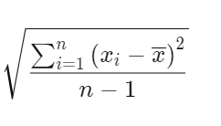
Standard Deviation
Standard deviation is calculated by taking the square root of a value derived from comparing data points to a collective mean of a population. The formula is:
Standard Déviation=
where: xi​=Value of the ith point in the data set
x=The mean value of the data set
n=The number of data points in the data set​

Slide 7
Mean Deviation
Mean deviation is used to compute how far the values in a data set are from the center point. Mean, median, and mode all form center points of the data set. In other words, the mean deviation is used to calculate the average of the absolute deviations of the data from the central point.

Slide 8
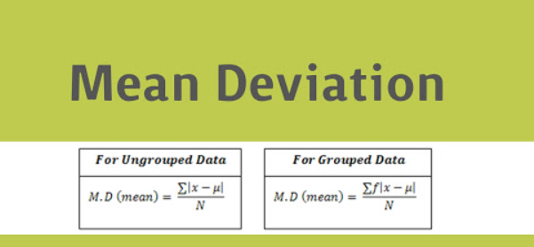
Mean Deviation

Slide 9
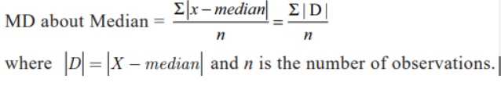
Mean Deviation

Slide 10
Quartile Deviation
Quartile deviation depends on the difference between the first quartile and the third quartile in the frequency distribution. The difference is also known as the interquartile range. The difference divided by two is known as quartile deviation or semi-interquartile range.
The quartile deviation or semi-interquartile range is the majority used in a case where one wants to learn or say a study about the dispersion of the observations or the samples of the given data sets that lie in the main or middle body of the given series.

Slide 11
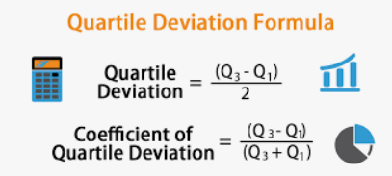
Quartile Deviation

